Slide 1
Flight-Price-Prediction Project

Slide 2
Flight Price Prediction
Exploratory Data Analysis

Slide 3
Steps
Creating my own dataset using web scraping
Importing the libraries needed for my project
Loading the dataset/Creating my dataframe
Checking the head of the dataset(first five rows)
Checking the shape of the dataset
Checking the datatypes
Checking for null values if any
These data analysis steps help us to get an overview of our dataset and also help us in our preprocessing of our data.

Slide 4
Flight Price Prediction
Preprocessing of the data

Slide 5
Steps and Description
I have checked for null values and there are some null values present,I have removed it using interpolate method.
I have label encoded the object type columns in the dataset.
I have checked the correlation between dependant and independent variables using heatmap. I have seen most of the independent variables are correlated with each other and the target variable is positively correlated with a very few independent variables.
I have done some visualization using histogram.
I have checked outliers using boxplots , outliers are present.
I also have checked for skewness in my data, but the skewness present is very negligible, so I don’t consider it.
I have splitted the dependant and independent variables into x and y.
I have scaled the data using StandardScaler method and made my data ready for model building.

Slide 6
Observation
From the correlation matrix (heatmap), I have seen most of the independent variables are correlated with each other and the target variable is positively correlated with a very few independent variables.

Slide 7
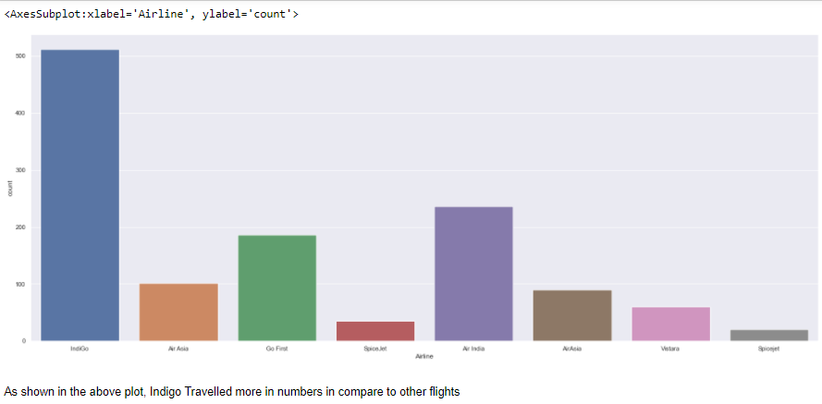
Some more preprocessing steps
Some visualization is done using histogram,boxplots, Countplots where we can see how our data look like. I have attached some of the screenshots.

Slide 8
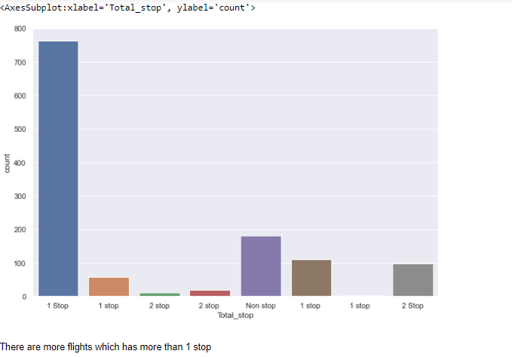

Slide 9
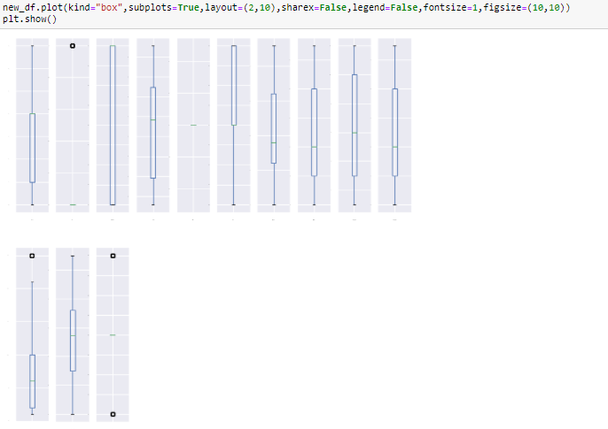
Now, I will see if any outliers are present in the data using boxplots. I will use zscore method to remove it. By removing outliers ,we can clean our data.
Outliers are present which can be seen from the plots.

Slide 10
Flight Price Prediction
Model building

Slide 11
Explanation
For model building, I have used 5 Regressor models(DecisionTreeRegressor(),RandomForestRegressor(),AdaBoostRegressor(),LinearRegression(),GradientBoostingRegressor(), KneighborsRegressor),out of which RandomForestRegressor model is the best model for my dataset.
For better accuracy of the model, I have used hyperparameter tuning (DecisionTreeRegressor() and I have achieved 100% accuracy.

